Slide 1
MFIX and Exascale Computing
August 9, 2018
Jordan Musser

Slide 2
Outline
Background
What is MFIX?
What is Exascale / ECP?
What is our target?
What is our starting point?
Current state of development
Low Mach projection method
Managing fluid work
Managing particle work
Managing geometries
Future work
Planned development
TBD development

Slide 3
Outline
Background
What is MFIX?
What is Exascale / ECP?
What is our target?
What is our starting point?
Current state of development
Low Mach projection method
Managing fluid work
Managing particle work
Managing geometries
Future work
Planned development
TBD development

Slide 4
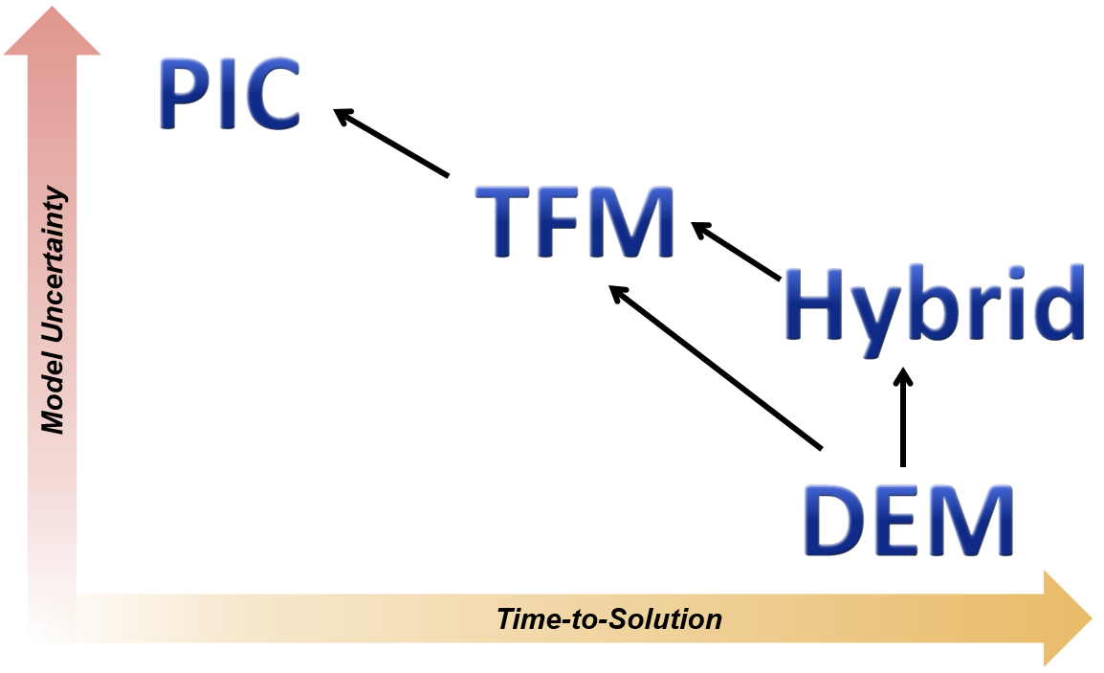
MFIX
What is MFIX?
SIMPLE Fluid solver coupled to three different solids models
Energy and species equation support
Distributed memory parallelism (MPI)
Cartesian grid cut-cell for realistic geometries
Two-Fluid Model (TFM)
Discrete Element Model (DEM)
Particles In Cell (PIC)
PDEs describe fluid and solids as interpenetrating continua.
PDEs describe fluid. Newton’s Laws of motion to track particles and resolve collisions.
PDEs describe fluid. Contrived laws approximate inter-parcel forces.

Slide 5
Exascale Computing Project (ECP)
What is Exascale/ECP?
Exascale supercomputers will be capable of a quintillion (10¹⁸) calculations each second
ECP is a joint effort of two DOE organizations
Office of Science
National Nuclear Security Administration (NNSA)
ECP has three key focus areas
Application Development
Software Technology
Hardware and Integration
exascaleproject.org
“The ECP is focused on accelerating the delivery of a capable exascale computing ecosystem to provide breakthrough solutions that can address our most critical challenges in scientific discovery, energy assurance, economic competitiveness, and national security.”

Slide 6
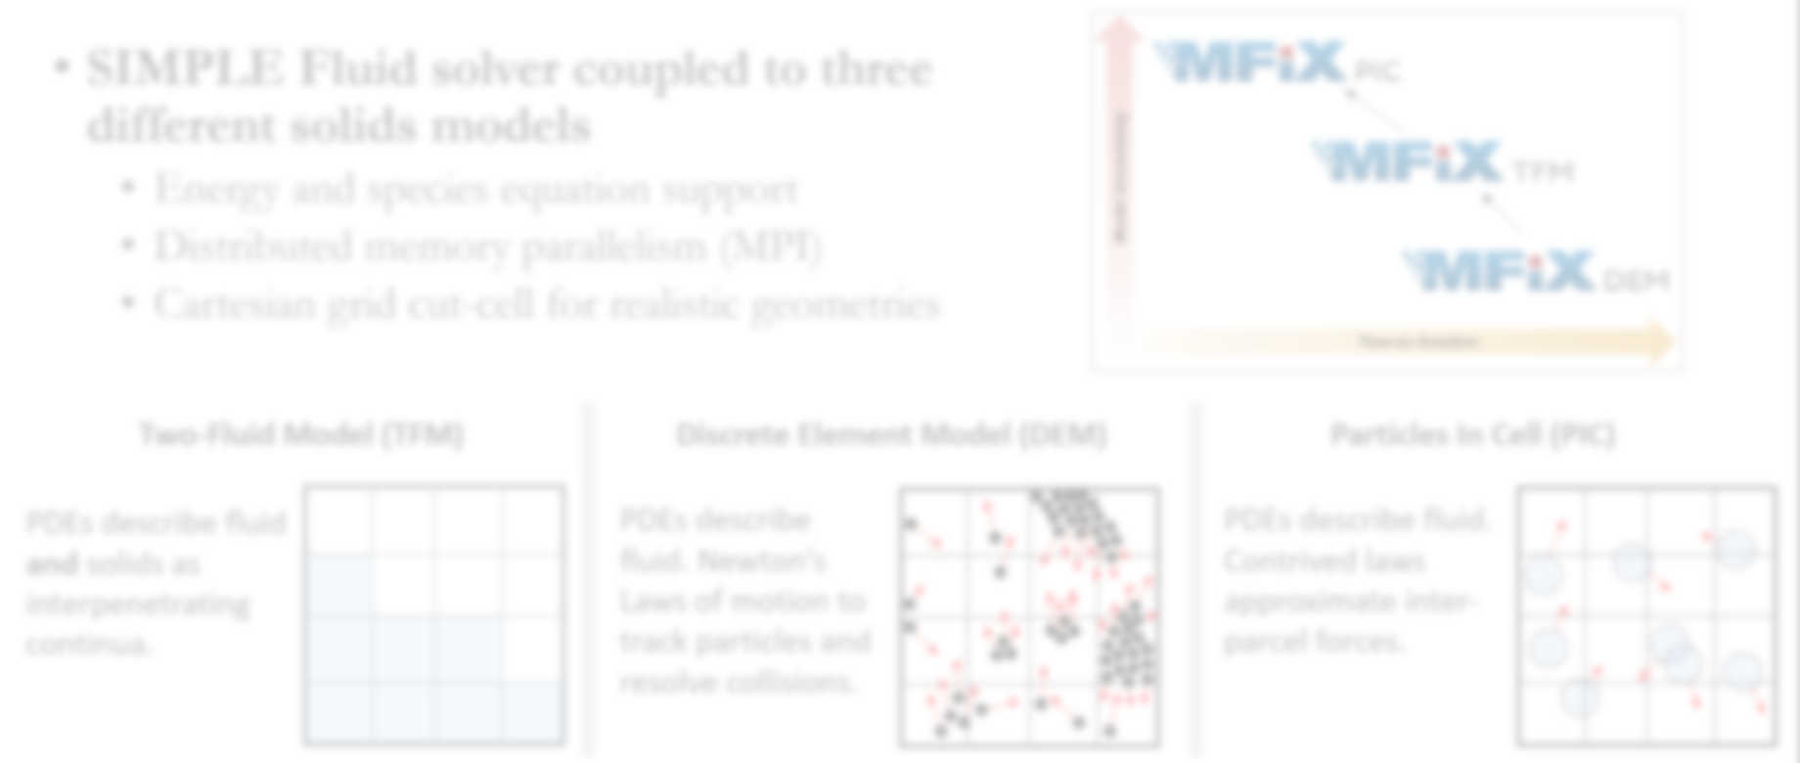
MFIX-Exa
What is MFIX-Exa?
Discrete Element Model (DEM)
PDEs describe fluid. Newton’s Laws of motion to track particles and resolve collisions.

Slide 7
MFIX-Exa
Project Team and Goal
60+ years of experience in multiphase modeling and MFIX (NETL and CU)
60+ years of experience in large-scale, multiscale multiphysics applications (LBNL)
90+ years of experience in high performance computing
Madhava Syamlal (PI) Jordan Musser (co-PI)
William Fullmer
Ann Almgren (co-PI)
John Bell (co-PI)
Michele Rosso
Johannes Blaschke
1m
Christine Hrenya (co-PI)
Thomas Hauser (co-PI)
Peiyuan Liu
FY19 Key Performance Parameter (KPP):
Cold-flow simulation of full chemical looping reactor with 10⁷ particles
MFIX-DEM with 10⁶ particles

Slide 8
Outline
Background
What is MFIX?
What is Exascale / ECP?
What is our target?
What is our starting point?
Current state of development
Low Mach projection method
Managing fluid work
Managing particle work
Managing geometries
Future work
Planned development
TBD development

Slide 9
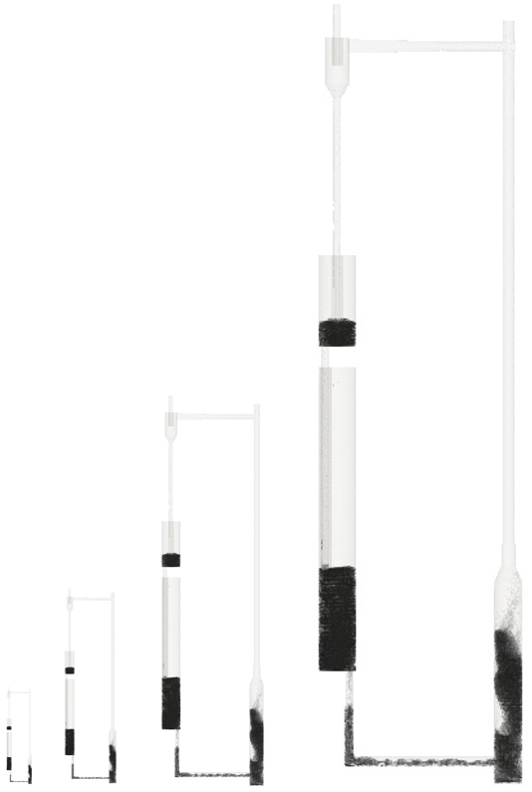
Where is MFIX-DEM today?
MFIX-Exa KPP baseline
Geometric scaling of CLR
MFIX version R2016-1
No “tuning” performance
Naïve MPI decomposition
Problem scaled by doubling lengths in all directions.
8m
Nodes | Cores | Cells | Particles
1 | 64 | 660,000 | 1,115,999
8 | 512 | 5,280,000 | 9,445,748
64 | 4,096 | 42,240,000 | 76,771,071
512 | 32,768 | 337,920,000 | 619,427,261
871 μm HDPE particles
1m

Slide 10
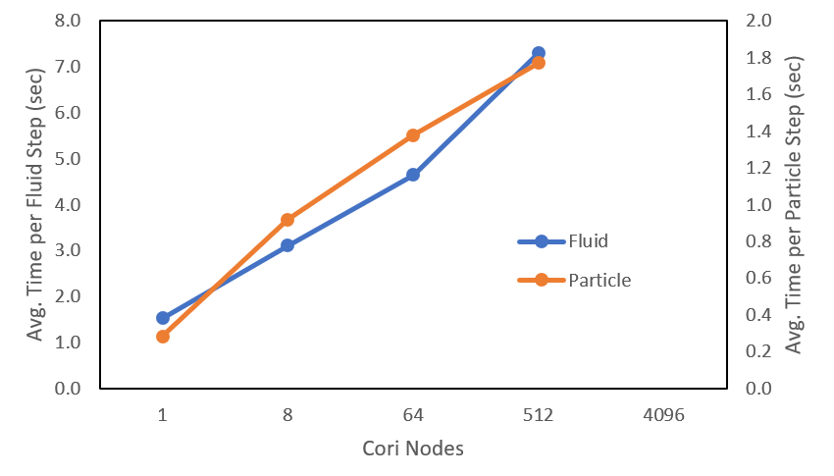
Where is MFIX-DEM today?
MFIX-Exa KPP baseline (cont.)
Problem scaled by doubling lengths in all directions.
8m
*Averages were taken over ten steps.
1m

Slide 11
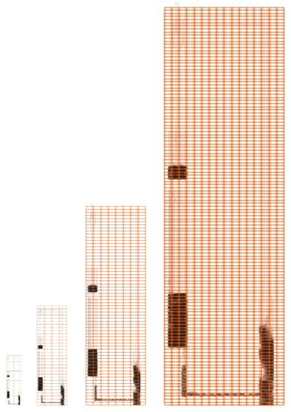
Where is MFIX-DEM today?
MFIX-Exa KPP baseline (cont.)
Initial problem size
1 KNL node (64 cores)
2x16x2 domain decomposition
Naïve domain decomposition assigns cores to “dead space” where there is no fluid or particle work.
8m
1m
Largest scaled size
512 KNL nodes (32,768 cores)
16x128x16 domain decomposition
Notes:
The physical space covered by each MPI process is the same as the problem is scaled.
As the domain size is increased and more cores are added, more cores go to covering dead space.
Minor improvement may be achieved by tuning the gird layout but unable to balance both fluid and particle work and there are limitations on improvement because of the block-structure layout of MPI processes in MFIX.

Slide 12
Where is MFIX-DEM today?
Limitations of SIMPLE
Fluid solver (SIMPLE) is also problematic
Two iterations per time step (minimum)
Four linear solves per iteration
Iterative linear solver (BiCGstab)
A lot of work per time step
A lot of global communication per internal iteration

Slide 13
Outline
Background
What is MFIX?
What is Exascale / ECP?
What is our target?
What is our starting point?
Current state of development
Low Mach projection method
Managing fluid work
Managing particle work
Managing geometries
Future work
Planned development
TBD development

Slide 14
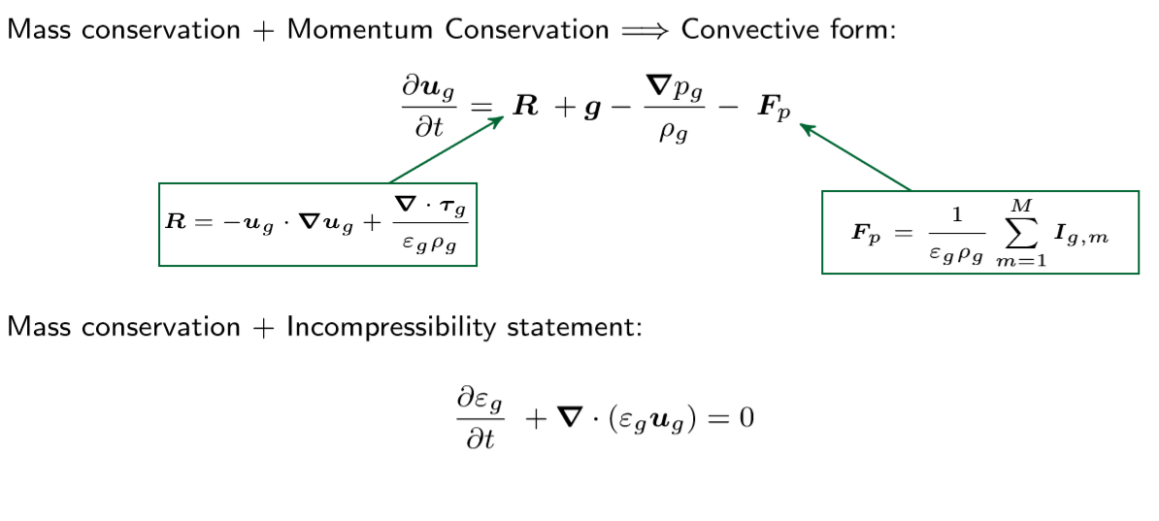
Current state of development
Low Mach number projection method (cont.)

Slide 15
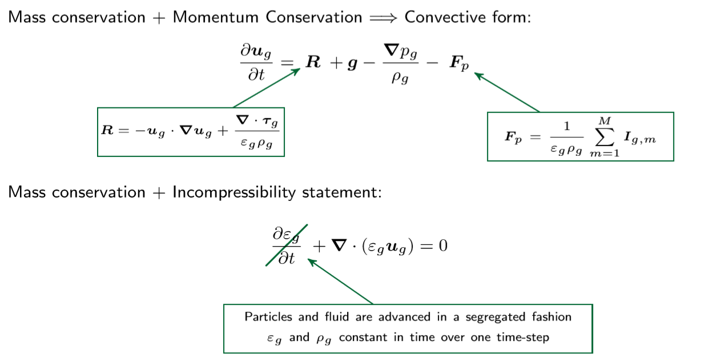
Current state of development
Low Mach number projection method (cont.)

Slide 16
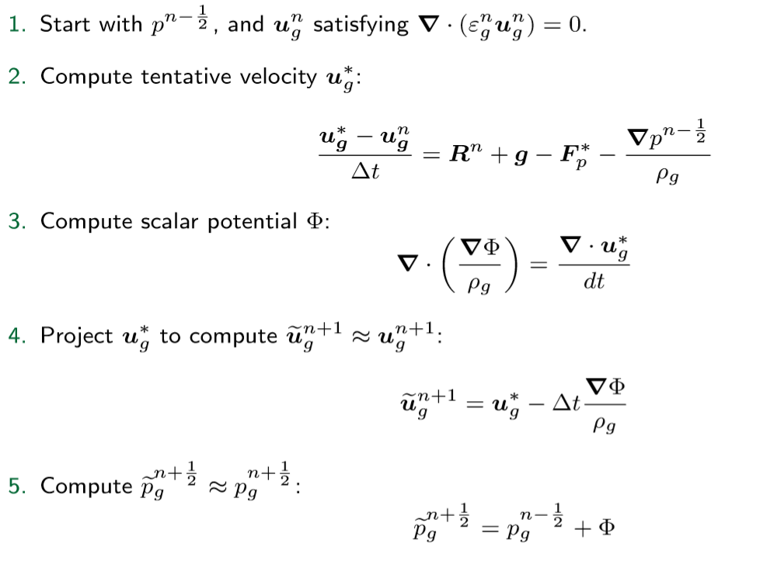
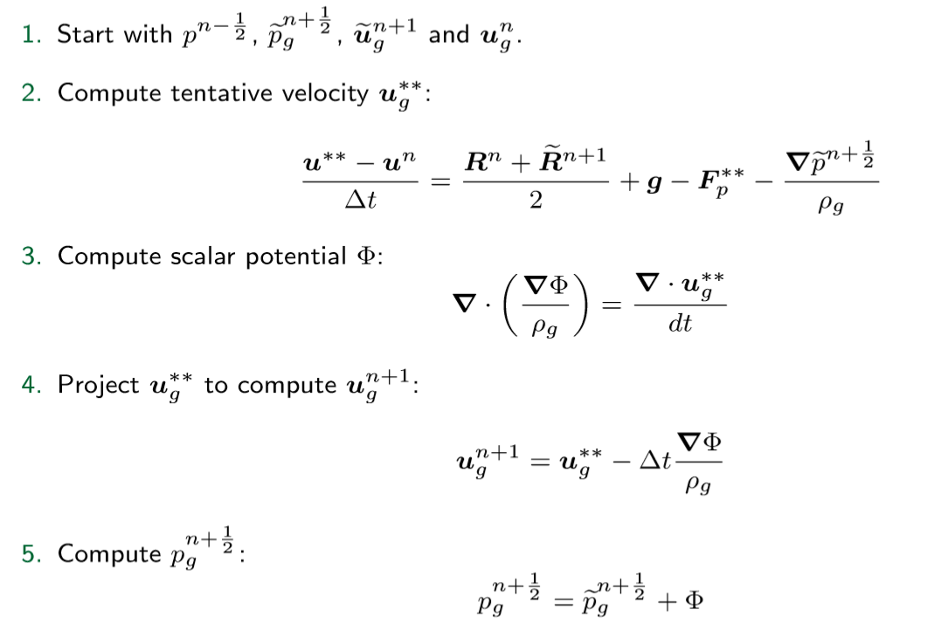
Current state of development
Low Mach number projection method (cont.)
Predictor Step
Corrector Step

Slide 17
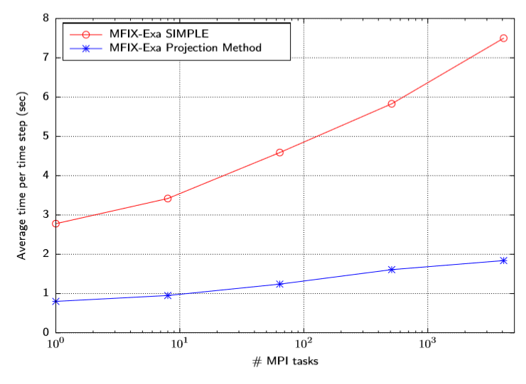
Current state of development
Low Mach number projection method (cont.)
Initial scaling study
Implementation Evolution

Slide 18
Current state of development
Managing fluid work
Domain
Fluid domain is decomposed into grids with one or more grid per MPI process.
Each grid can be broken into smaller tiles with one or more tiles per OpenMP thread.
These small patches into Fortran kernels.
Grid
Grid
Tile
Cells
Tile
Tile
Tile
Notes:
More grids than MPI processes gives us the ability to balance fluid work. This isn’t really an issue with cold flow but may become important when we start to look at reactions.
Distributed and shared memory parallelism are managed at the function call level.

Slide 19
Current state of development
Managing particle work
The simplest approach is to have particles use the same grids and tiles as the fluid.
This is essentially what MFIX does
Limits ability to load balance particle work
A dual grid methodology allows the fluid and particles to live on separate grids.
Load balance is done using either a KD Tree or KnapSack algorithm
Regridding is preformed at a user defined interval to rebalance particle work
Tiles are still used to breakup particle work for OpenMP threads
Domain
Grids
Particle Grids
KD Tree illustration

Slide 20
Current state of development
Managing work (cont.)
Managing fluid and particle work with girds and tiles gives us the ability to make better use of computing resources.
Of course, there is no “free lunch”
Dual grid brings data copying costs
Excessive gridding increases comms

Slide 21
Current state of development
Managing geometries (particles)
MFIX-DEM uses STLs to specify reactor geometries
Fluid and particles may not see the same geometry
Leads to edge-cases where particles may interact with multiple facets at the same time making particle/wall collisions appear stiff
MFIX-Exa uses a level-set function for the reactor geometry
Fast evaluation of complex geometries.
Level-set is specified on its own grid

Slide 22
Outline
Background
What is MFIX?
What is Exascale / ECP?
What is our target?
What is our starting point?
Current state of development
Low Mach projection method
Managing fluid work
Managing particle work
Managing geometries
Future work
Planned development
TBD development

Slide 23
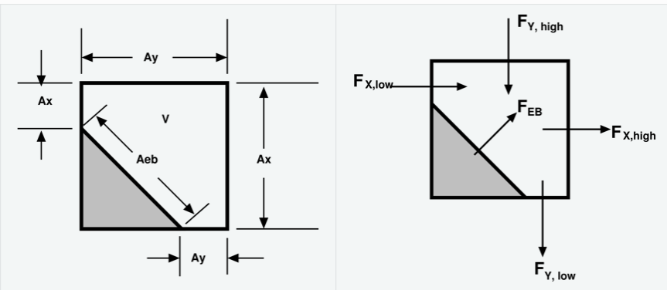
Future work
Planned development
Extend embedded boundaries (EB) to projection method
First pass with fully cell-center data layout
Move to nodal pressure when multigrid solver becomes available in AMReX
Add local mesh refinement for fluid
Already exists (to some extent) for particles + EB
Will be used to capture thin internal walls
Identify key components for initial GPU implementation
Add energy and chemistry transport for fluid and particles

Slide 24
Future work
TBD development
In situ data analysis / visualization – What information we want? How do we get that data out? How much data do we store? What would we do with it when we are done?
Initial condition boot strapping - How do you get a reasonable IC so you don’t need to model several hours of physical time to get to a meaning operational state?
Risk mitigation – What do we do if we can’t make it performant? Are there other models or a hybrid approach we can have ready ‘just in case’?

Slide 25
Thank you

Slide 26
MFIX-Exa
Project Overview
FY17 development
Remove all non-essential models (TFM,PIC,…)
Replace native arrays with AMReX arrays
Implement dual grid for fluid and particles
FY18 development
Enable particle-EB interactions
Replace SIMPLE fluid solver with low Mach number projection solver
Enable fluid EB interactions (basic geometries)
FY19 development
Local mesh refinement
Initial implementation for hybrid CPU+GPU
Simulate CLR with 10⁷ particles
AMReX is a software framework for massively parallel, block-structured adaptive mesh refinement (AMR) applications.
C++ and Fortran interfaces
Support for cell-centered, face-centered, edge-centered, and nodal data
Support for particles
Embedded boundary description of irregular geometry
Parallelization via flat MPI, OpenMP, hybrid MPI/OpenMP, or MPI/MPI
Built-in profiling tools
https://amrex-codes.github.io/amrex/overview.html

Slide 27
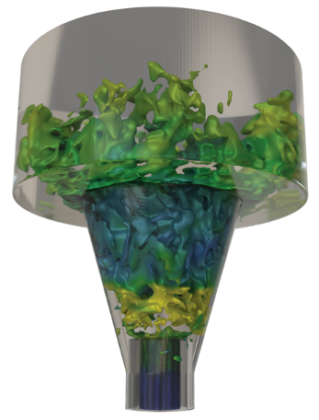
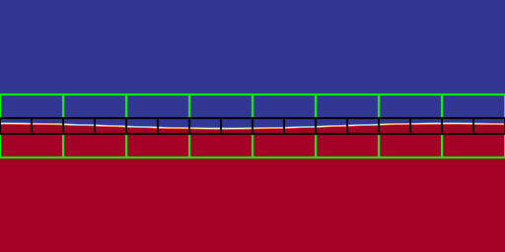
MFIX-Exa
What is AMReX?
AMReX is a software framework for massively parallel, block-structured adaptive mesh refinement (AMR) applications.
compressible high speed swirling jet conducted using the PeleC simulation code created by NREL & LBNL
C++ and Fortran interfaces
Support for cell-centered, face-centered, edge-centered, and nodal data
Support for particles
Embedded boundary description of irregular geometry
Parallelization via flat MPI, OpenMP, hybrid MPI/OpenMP, or MPI/MPI
Built-in profiling tools
Depicted above is a Kelvin-Helmholtz instability using 3 total levels of refinement generated by the publicly available IAMR code for solving the variable-density incompressible Navier-Stokes equations
https://amrex-codes.github.io/amrex/overview.html

